Slide 1
How processor Works?
Fetching Cycles
  The fetch cycle takes the instruction required from memory, stores it in the instruction register, and
  moves the program counter on one so that it points to the next instruction.
Execute cycle
  The actual actions which occur during the execute cycle of an instruction.
  depend on both the instruction itself and the addressing mode specified to be used to access the data that may be required.
1

Slide 2
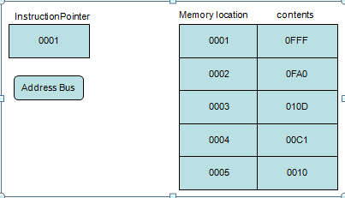
Fetching an instruction
Step 1
Instruction pointer (program counter) hold the address of the next instruction to be fetch.

Slide 3
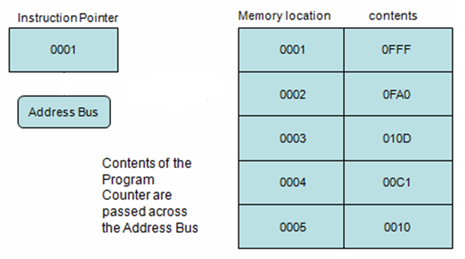
FETCHING AN INSTRUCTION (cont.)
Step 2

Slide 4
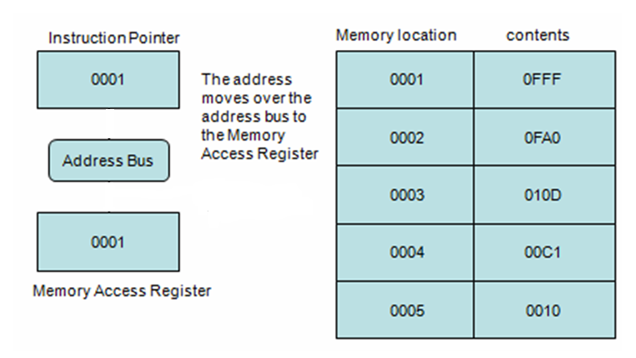
FETCHING AN INSTRUCTION (cont.)
Step 3

Slide 5
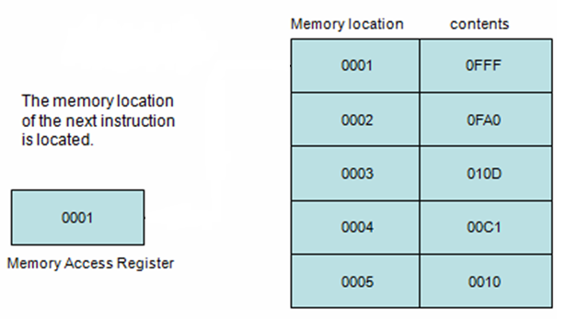
FETCHING AN INSTRUCTION (cont.)
Step 4

Slide 6
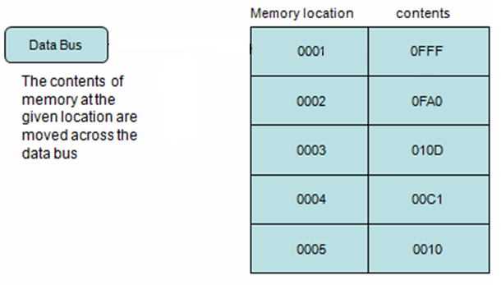
FETCHING AN INSTRUCTION (cont.)
Step 5

Slide 7
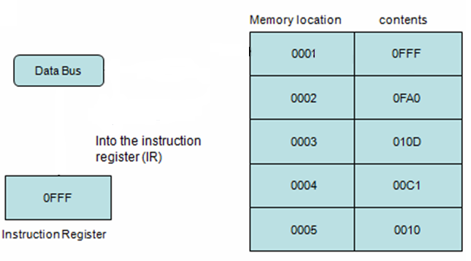
FETCHING AN INSTRUCTION (cont.)
Step 6

